Slide 1
Object Oriented Software Engineering (OOSE)
22CS017
Black-Box Testing Techniques
Prepared By
Dr. Mankirat Kaur

Slide 2
Index
Black-Box Testing Techniques:
Syntax-Driven Testing
Equivalence partitioning
Steps of Black Box Testing
Features of Black box testing
Advantages and Disadvantages of Black Box Testing

Slide 3
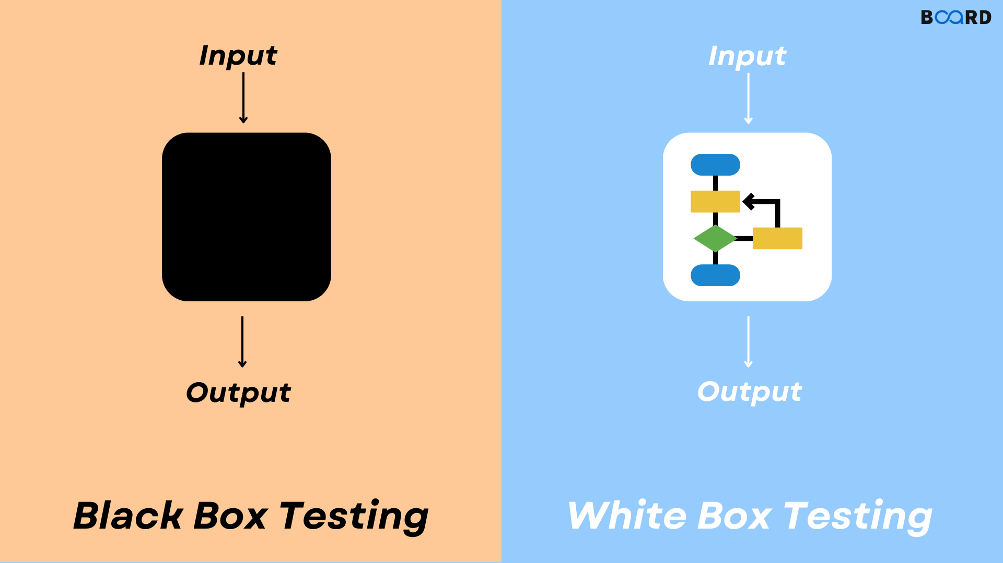
Black-Box Testing
Black-box testing is a type of software testing in which the tester is not concerned with the internal knowledge or implementation details of the software but rather focuses on validating the functionality based on the provided specifications or requirements.
Figure 1: Black box and White box testing

Slide 4
Comparison of BB and WB testing
Black Box testing | White Box testing
It is a way of software testing in which the internal structure or the program or the code is hidden and nothing is known about it. | It is a way of testing the software in which the tester has knowledge about the internal structure or the code or the program of the software.
Implementation of code is not needed for black box testing. | Code implementation is necessary for white box testing.
It is a functional test of the software. (behaviour testing) | It is a structural test of the software. (logical testing)
It is applicable to the higher levels of testing of software. | It is generally applicable to the lower levels of software testing.
It is also called closed testing | It is also called as clear box testing.
Example: Search something on google by using keywords. | Example: By input to check and verify loops
It is least time consuming. | It is most time consuming.

Slide 5
Black-Box Testing Techniques
Black box testing can be done in the following ways:
Syntax-Driven Testing – This type of testing is applied to systems that can be syntactically represented by some language. For example, language can be represented by context-free grammar. In this, the test cases are generated so that each grammar rule is used at least once.
Equivalence partitioning – It is often seen that many types of inputs work similarly so instead of giving all of them separately we can group them and test only one input of each group. The idea is to partition the input domain of the system into several equivalence classes such that each member of the class works similarly, i.e., if a test case in one class results in some error, other members of the class would also result in the same error.

Slide 6
Steps of Black Box Testing
1. Identification of equivalence class – Partition any input domain into a minimum of two sets: valid values and invalid values.
Example: if the valid range is 0 to 100, select one valid input like 49 and one invalid like 104.
2. Generating test cases – (i) To each valid and invalid class of input assign a unique identification number. (ii) Write a test case covering all valid and invalid test cases considering that no two invalid inputs mask each other
To calculate the square root of a number, the equivalence classes will be:
(a) Valid inputs:
The whole number which is a perfect square-output will be an integer.
The entire number which is not a perfect square-output will be a decimal number.
Positive decimals
(b) Invalid inputs:
Negative numbers(integer or decimal).
Characters other than numbers like “a”,”!”,”;”, etc.

Slide 7
Steps of Black Box Testing cont..
3. Boundary value analysis – Boundaries are very good places for errors to occur. Hence, if test cases are designed for boundary values of the input domain then the efficiency of testing improves and the probability of finding errors also increases. For example – If the valid range is 10 to 100 then test for 10,100 also apart from valid and invalid inputs.
4. Cause effect graphing – This technique establishes a relationship between logical input called causes with corresponding actions called the effect. The causes and effects are represented using Boolean graphs. The following steps are followed:
Identify inputs (causes) and outputs (effect).
Develop a cause-effect graph.
Transform the graph into a decision table.
Convert decision table rules to test cases.

Slide 8
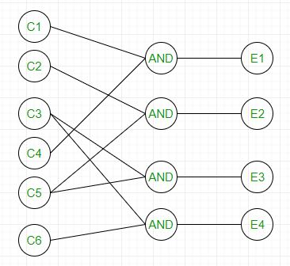
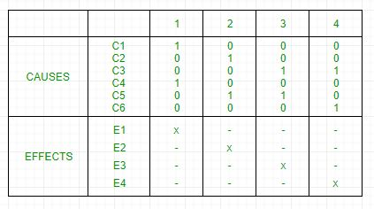
Steps of Black Box Testing cont..
4. Cause effect graphing
Figure 2: Cause Effect Graph
Figure 3: Decision Table

Slide 9
Steps of Black Box Testing cont..
Each column corresponds to a rule which will become a test case for testing. So there will be 4 test cases.
5. Requirement-based testing – It includes validating the requirements given in the SRS of a software system.
6. Compatibility testing – The test case results not only depends on the product but is also on the infrastructure for delivering functionality. When the infrastructure parameters are changed it is still expected to work properly. Some parameters that generally affect the compatibility of software are:
Processor (Pentium 3, Pentium 4) and several processors.
Architecture and characteristics of machine (32-bit or 64-bit).
Back-end components such as database servers.
Operating System (Windows, Linux, etc).

Slide 10
Features of Black Box Testing
What can be identified by Black Box Testing
Discovers missing functions, incorrect function & interface errors
Discover the errors faced in accessing the database
Discovers the errors that occur while initiating & terminating any functions.
Discovers the errors in performance or behaviour of software.

Slide 11
Features of Black Box Testing
Independent testing: Black box testing is performed by testers who are not involved in the development of the application, which helps to ensure that testing is unbiased and impartial.
Testing from a user’s perspective: Black box testing is conducted from the perspective of an end user, which helps to ensure that the application meets user requirements and is easy to use.
No knowledge of internal code: Testers performing black box testing do not have access to the application’s internal code, which allows them to focus on testing the application’s external behaviour and functionality.
Requirements-based testing: Black box testing is typically based on the application’s requirements, which helps to ensure that the application meets the required specifications.

Slide 12
Black Box Testing Techniques
Different testing techniques: Black box testing can be performed using various testing techniques, such as functional testing, usability testing, acceptance testing, and regression testing.
Easy to automate: Black box testing is easy to automate using various automation tools, which helps to reduce the overall testing time and effort.
Scalability: Black box testing can be scaled up or down depending on the size and complexity of the application being tested.
Limited knowledge of application: Testers performing black box testing have limited knowledge of the application being tested, which helps to ensure that testing is more representative of how the end users will interact with the application.

Slide 13
Black Box Testing Techniques
Advantages of Black box Testing
The tester does not need to have more functional knowledge or programming skills to implement the Black Box Testing.
It is efficient for implementing the tests in the larger system.
Tests are executed from the user’s or client’s point of view.
Test cases are easily reproducible.
It is used in finding the ambiguity and contradictions in the functional specifications.

Slide 14
Black Box Testing Techniques
Disadvantages of Black box Testing
There is a possibility of repeating the same tests while implementing the testing process.
Without clear functional specifications, test cases are difficult to implement.
It is difficult to execute the test cases because of complex inputs at different stages of testing.
Sometimes, the reason for the test failure cannot be detected.
Some programs in the application are not tested.
It does not reveal the errors in the control structure.
Working with a large sample space of inputs can be exhaustive and consumes a lot of time.

Slide 15
Practice Questions
Q1. The value of boundary analysis belongs to? a) White Box Testing b) Black Box Testing c) White Box & Black Box Testing d) None of the mentioned Answer: b
Q2. Which of the following is a method of Black box testing?
Boundary Value Analysis
Basic Path Testing
Code Path Testing
None of these
Answer: a
Q3. System testing is a
a) Black box testing
b) Grey box testing
c) White box testing
d) Both a and b
Answer: a
Q4. Describe the criteria that need to be satisfied for a good test.

Slide 16
Bibliography
https://www.javatpoint.com/black-box-testing
https://www.tutorialspoint.com/software_testing_dictionary/black_box_testing.htm
https://www.softwaretestinghelp.com/black-box-testing/
https://www.softwaretestinghelp.com/types-of-software-testing/
https://www.tutorialspoint.com/software_engineering/software_design_strategies.htm

Slide 17
THANK YOU

